Slide 1

Programming Languages
CS2S567: Professional Practice and Employability
________________________________________________________________________
Jessica Fealy – 18024092 Eduard Tenev – 18068234
Komal – 30010813 Harry Pearce – 18136044
Ben Harrison - 18142915

Slide 2
Ed

Slide 3

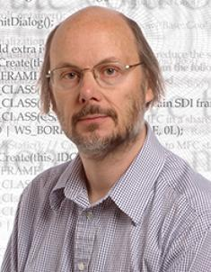

C++ Origins and History
Danish computer scientist Bjarne Stroustrup, is the man responsible for developing C++. Initially as an extension to C, later became it’s own language
Jessica Fealy - 18024092

Slide 4








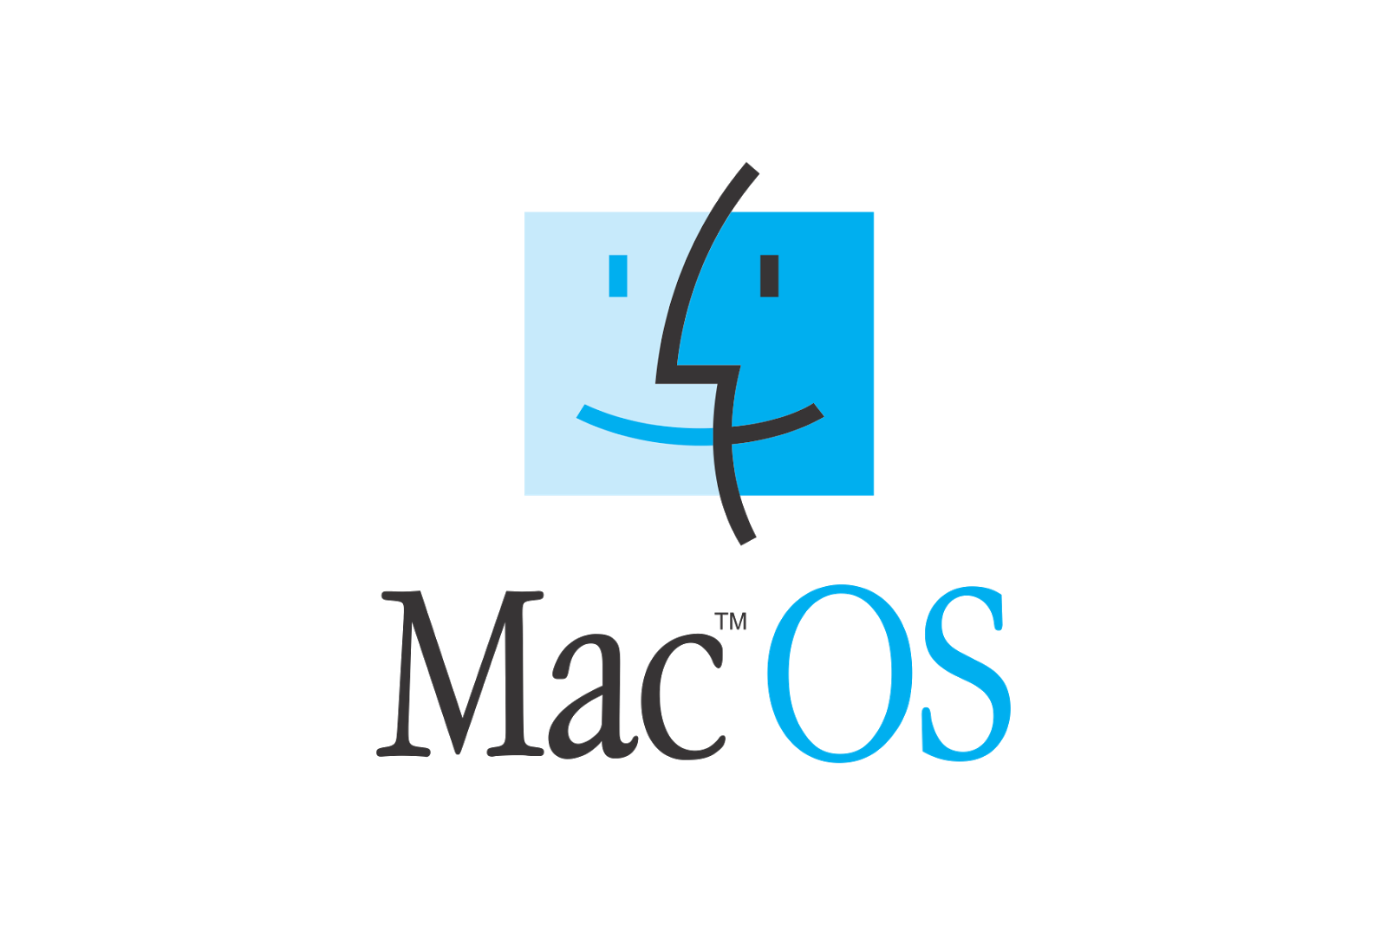




C++ Major uses
Many modern day applications will have a part of their development done in C++.
While most applications will have their consumer front face being operated by JavaScript or Python, their back ends will usually be written C++. This is the case for Spotify.
Some applications will exclusively use C++, such as Unity and Unreal Engines.
But every applications logo seen here use C++ in their development in one way, or another
Jessica Fealy - 18024092

Slide 5
Ben

Slide 6
Harry

Slide 7
Komal

